Slide 1
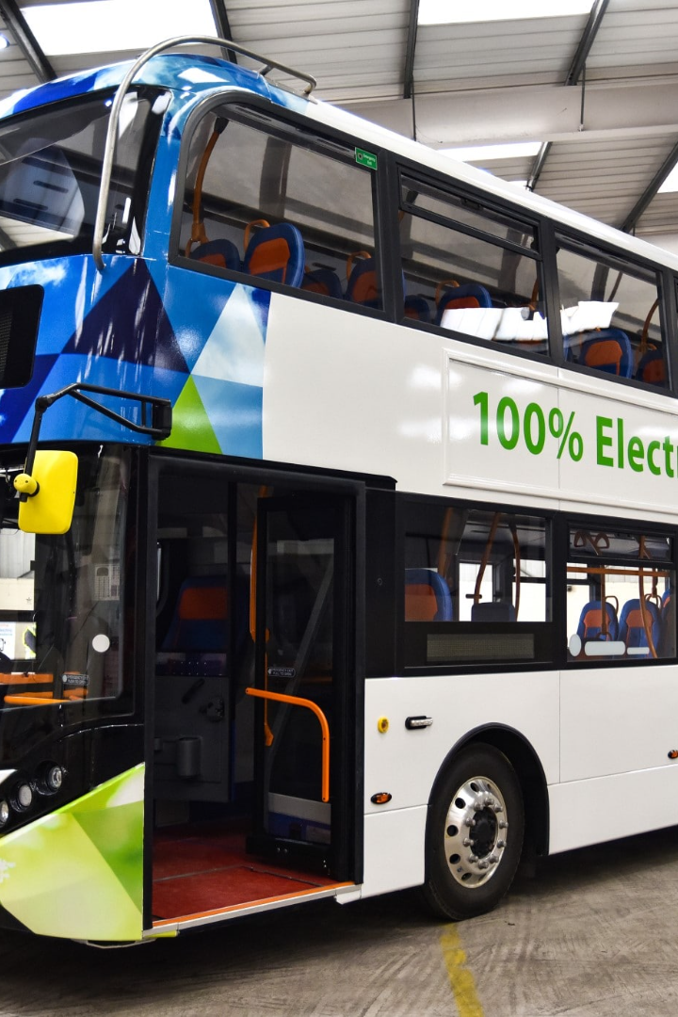
Bus Reservation System By Using
Binary Search Tree
Introduction
The presentation will explore the importance of a bus reservation system using a binary search tree and its benefits in enhancing efficiency and search capabilities.
by
AKANKSHA MISHRA (RA2211003011513)
ADITYA ROY (RA221103011539)
APARIJIT CHAKRABORTY (RA2211003011540)

Slide 2

Problem Statement
Design and implement a bus reservation system where seat information is managed using a Binary Search Tree (BST). The system should allow users to efficiently reserve seats, view seat availability, and enable administrators to manage bus details. Ensure a secure and user-friendly interface with features such as user authentication, real-time availability updates, and payment integration.

Slide 3

What is a Binary Search Tree?
A binary search tree is a data structure where each node has at most two children, a left child and a right child. It allows for efficient searching and insertion of elements.

Slide 4
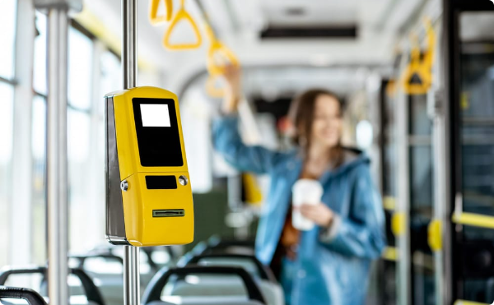

Implementation of a Bus Reservation System using a Binary Search Tree
Design and Architecture
Data Structures and Algorithms Utilized
The bus reservation system is designed to handle the reservation process and manage passenger data efficiently using a binary search tree structure.
The system leverages various data structures and algorithms like linked lists, queues, and binary search trees to store and manage the information effectively.

Slide 5

Benefits and Advantages of using a Binary Search Tree for Bus Reservation Systems
Efficiency and Performance Improvements
The binary search tree allows for quick search and retrieval operations, reducing the time taken for reservations and providing a seamless user experience.
Enhanced Search and Retrieval Capabilities
The BST's property of maintaining sorted data makes it efficient for retrieving information based on various criteria such as passenger names, seat numbers, and travel dates.

Slide 6

Challenges and Considerations in Implementing a Bus Reservation System using a Binary Search Tree
1
Handling Complex Scenarios and Edge Cases
The system needs to account for scenarios such as overlapping reservations, cancellations, and modifications while ensuring data consistency and reliability.
2
Maintenance and Scalability Challenges
As the system grows with an increase in users and routes, maintaining data integrity and ensuring scalability become crucial aspects that need to be addressed.

Slide 7
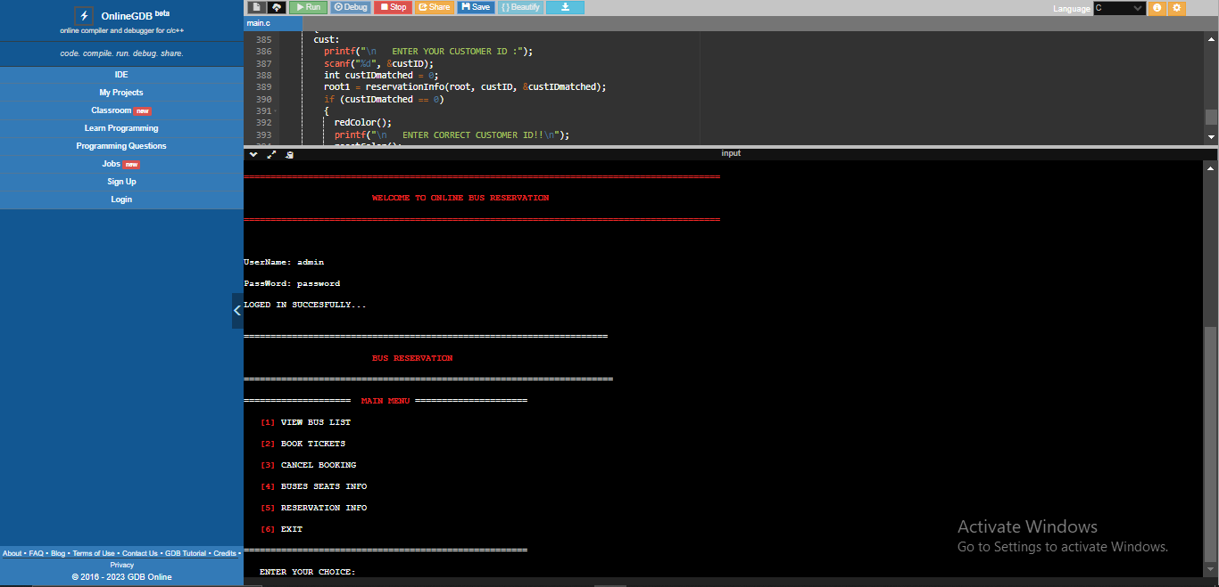
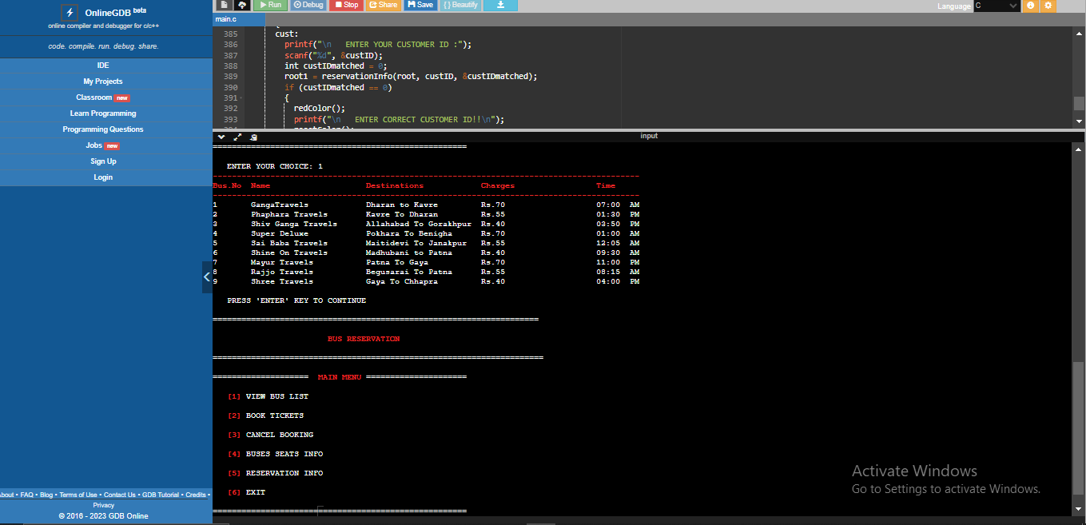
Outputs:

Slide 8

Conclusion
1
Recap of Main Points
The bus reservation system utilizing a binary search tree offers efficient searching, retrieval, and data management, enhancing the overall performance of the system.
Potential Future Developments and Improvements
2
Further advancements in the system can include the integration of real-time tracking, automated seat allocation algorithms, and enhanced user interfaces.

